Slide 1

Student Performance Index Predictive Model
A Machine Learning Approach

Slide 2
Index
Understanding the Problem Statement
Requirements
Life Cycle
Data Collection
Data Checks to perform
Exploratory data analysis
Data Pre-Processing
Model Training
Choose best model

Slide 3
Problem Statement
Objective: Develop a predictive model to forecast student performance based on various academic and socio-demographic factors.
Goals:
Understand the factors influencing student performance.
Predict maths score using a machine learning model.
Provide actionable insights for educators and policymakers.

Slide 4
Business Requirements
Schools and educational institutions can use the model to boost overall student performance.
Policymakers and school administrators can make more informed decisions regarding resource allocation, program implementation, and policy development.
Providing parents with insights into their children's performance and potential areas of improvement can foster stronger partnerships between schools and families, enhancing overall student support systems.

Slide 5
Life Cycle – Agile
Understanding the Problem Statement
Understanding the business requirements
Data Collection
Data Checks to perform
Exploratory data analysis
Data Pre-Processing
Model Training
Choosing best model

Slide 6
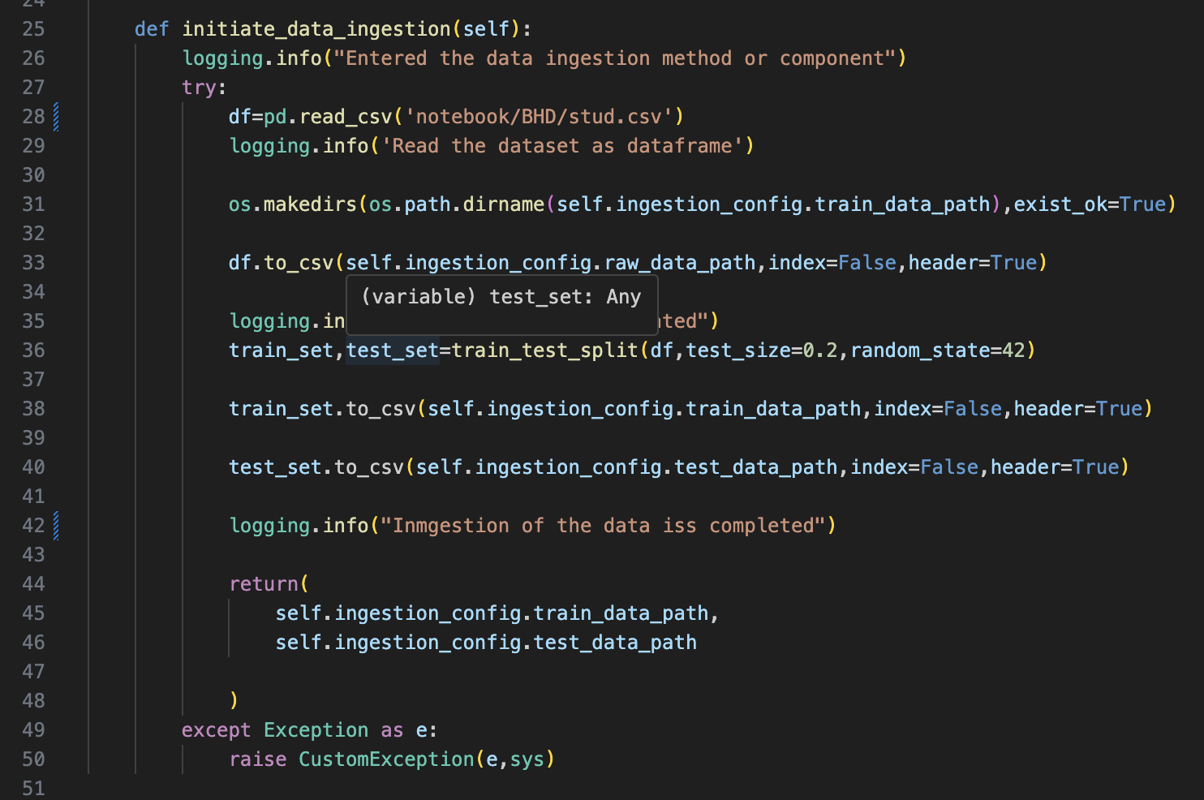
Data Understanding and Exploration
Steps involved:
Data Collection: Gather data on student performance.
Data Description: Summarize the dataset.
Exploratory Data Analysis (EDA): Visualize distributions and relationships.

Slide 7
Dataset information
gender : Male/female
race/ethnicity : Group A, B,C, D,E
parental level of education : bachelor's degree, some college, master's degree, associate's degree, high school)
lunch : having lunch before test (standard or free/reduced)
test preparation course : completed or not before test
math score
reading score
writing score

Slide 8
Data Preprocessing
Steps involved: Handling Missing Values: Imputation or removal.
Feature Engineering: Create new features or transform existing ones.
Categorical Variables: Encode using one-hot or label encoding.
Scaling: Normalize or standardize numerical features.

Slide 9
Model Training
Algorithm Selection: Use XGBoost.
Train-Test Split: Divide the dataset.
Hyperparameter Tuning: Optimize model parameters.
Model Training: Train the model on the training dataset.

Slide 10
Model Evaluation
Steps involved:
Performance Metrics: Use MAE, MSE, RMSE, and R-squared.
Cross-Validation: Ensure robustness and generalizability.
Residual Analysis: Check for patterns in residuals.

Slide 11
Model Interpretation
Feature Importance: Identify influential features.Partial Dependence Plots: Visualize feature effects.SHAP Values: Understand feature contributions.

Slide 12
Deployment

